Slide 1
Predictive analysis
Alfred Cheung

Slide 2
Introduction
Predicitve Analysis are analytics that help you forecast future performance and results
Define problem statement
Data collection
Data Cleaning
Data Analysis
Build Predictive Model
Validate Model
Deployment

Slide 3
Application
Help in future projection that help in numerous businesses etc.
Promotions
Pricing
Demand Planning
Campaign management
Customer acquisition
Budgeting and Forecasting
Fraud Detection

Slide 4
Roadmap (Cross Industry Standard Process for Data Mining) CRISP -DM
Business understanding
Data understanding
Data preparation
Modeling
Evaluation
Deployment

Slide 5
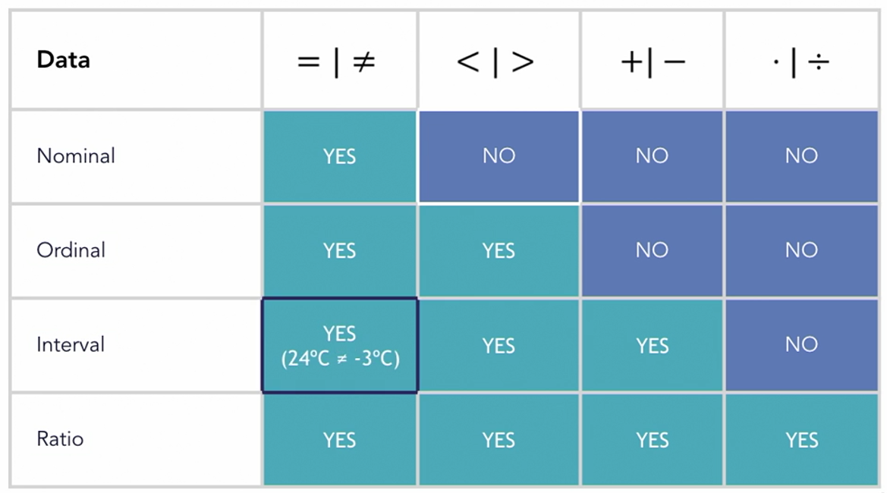
Data Types
Numerical
Interval (23,24,-3 degrees, no true zero point)
Ratio (no -100 sq feet home) multiply or divide
Categorical
Nominal (Blue, Red, Green)
Ordinal (ID: 1210,1211,1212)
Convert categoral data to numerical data

Slide 6
Main Library
Pandas
NumPy
Scikit-learn
Matplotlib
Seaborn

